Slide 1
Finger Movement
Based
Authentication
Jin Young Park
University of Washington Tacoma

Slide 2

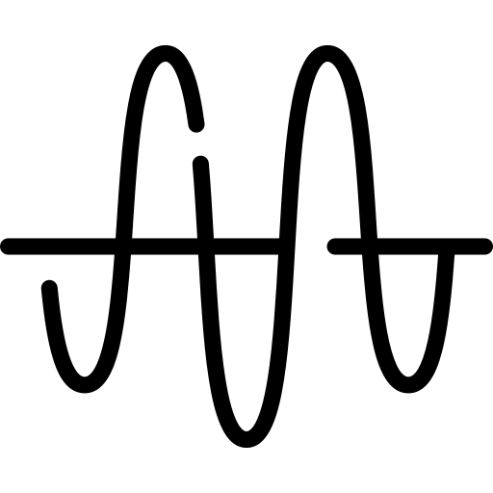
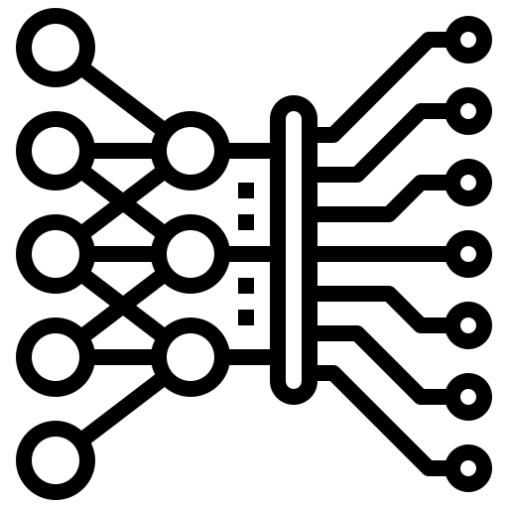
Overview
> Development of user authentication app using finger movement EMG signal
Finger Movement
Signal
User
Authentication
Classification

Slide 3



Approach
> App Structure is Based on FIDO Protocol
> Using Android studio, Python, and Chaquopy

Slide 4
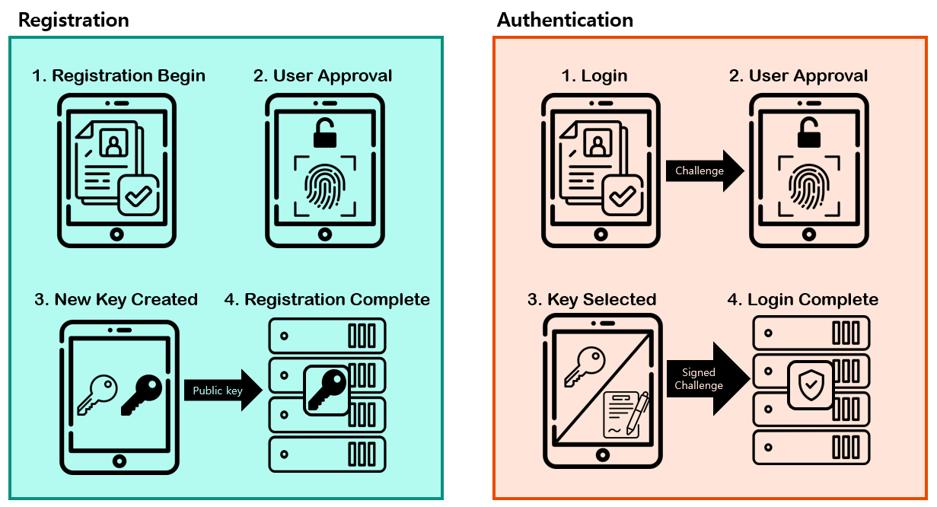
FIDO Protocol
https://fidoalliance.org/how-fido-works/

Slide 5
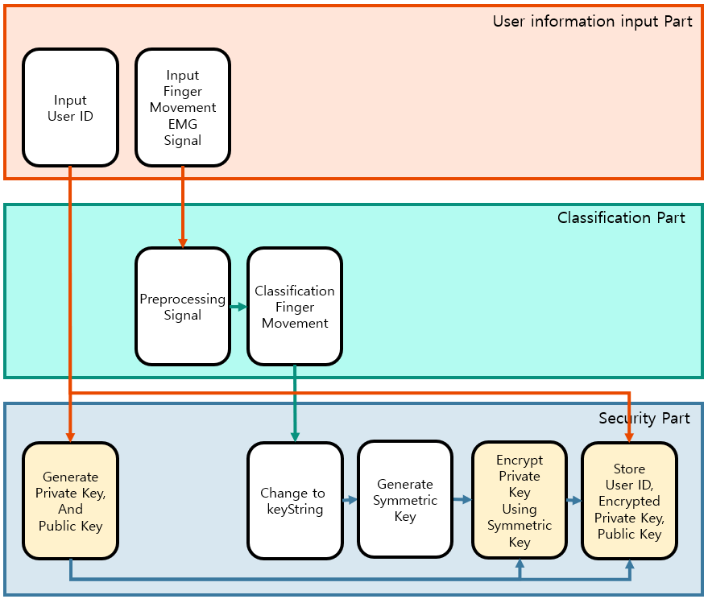
App Structure - Registration

Slide 6
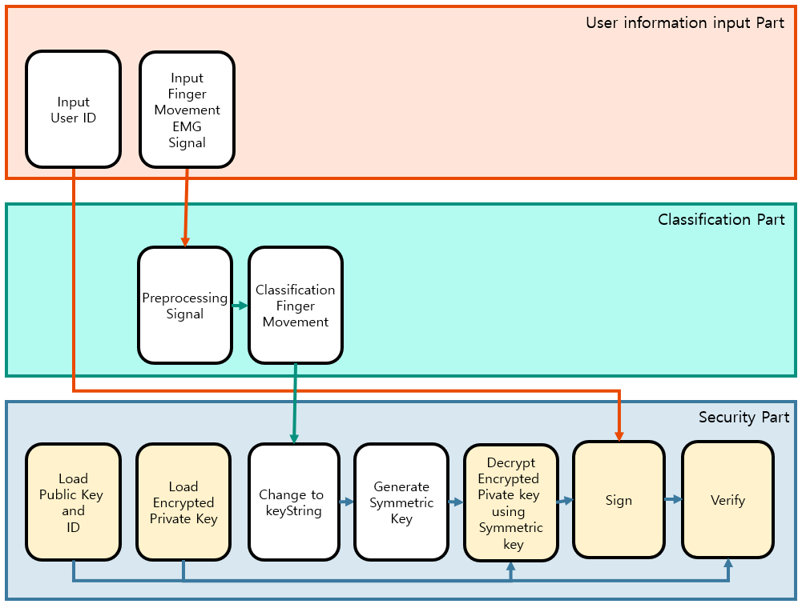
App Structure - authentication
The white steps are same procedure as the registration part

Slide 7
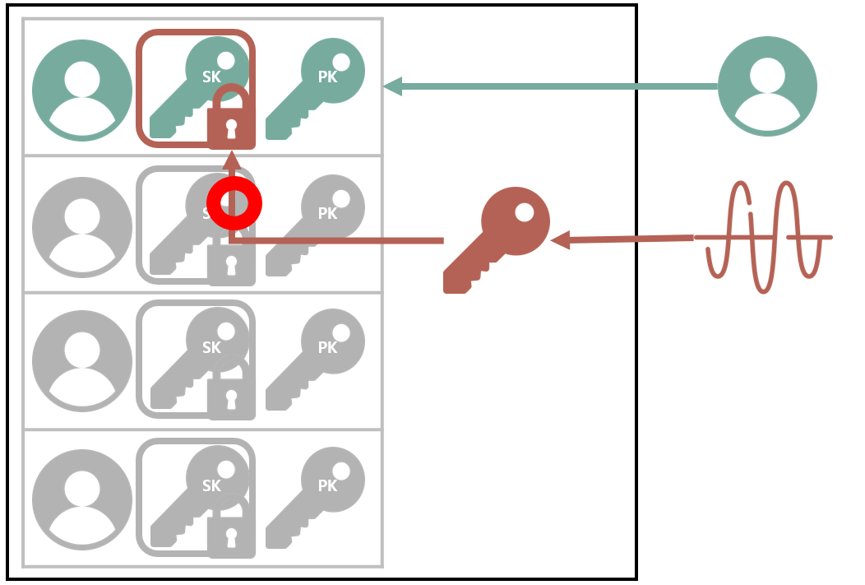
App Structure - authentication
Green
User ID
Encrypted Green
Private key
Green
Public key
Inputted Green UserID
The input
User ID and
input finger movement signal
are pair
→Authentication Success
New Red Symmetric key
Inputted Red Finger Movement EMG Signal

Slide 8
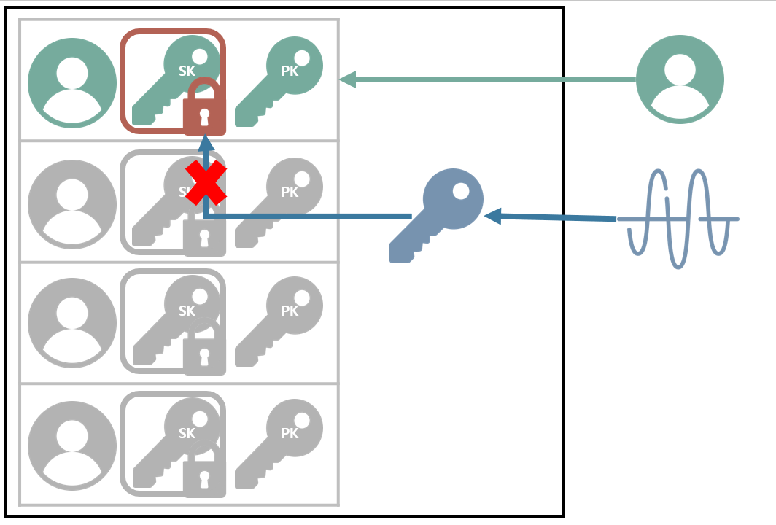
App Structure - authentication
Green
User ID
Encrypted Green
Private key
Green
Public key
Inputted Green UserID
The input
User ID and
input finger movement signal
are not pair
→Authentication
fail
Blue Symmetric key
Inputted Blue Finger Movement EMG Signal

Slide 9
The Implementation

Slide 10
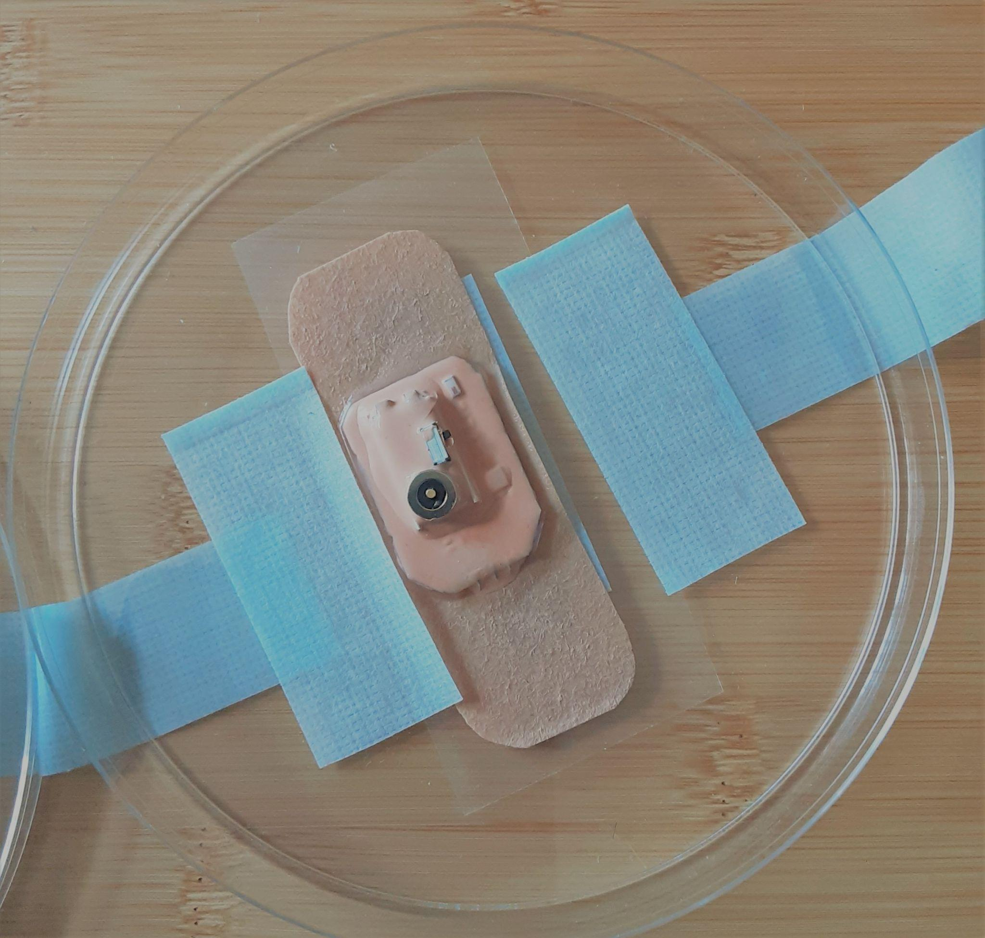
EMG Sensor
Developed by Georgia Institute of Technology
Measured EMG signal
Using Bluetooth Protocol
Single Channel Recording at 250Hz

Slide 11
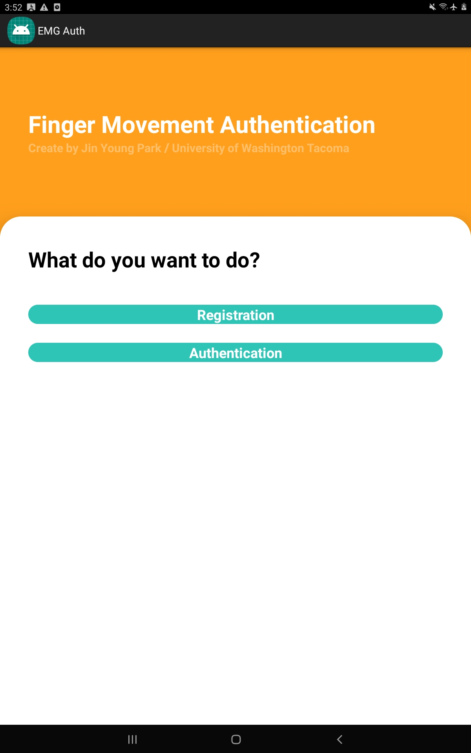
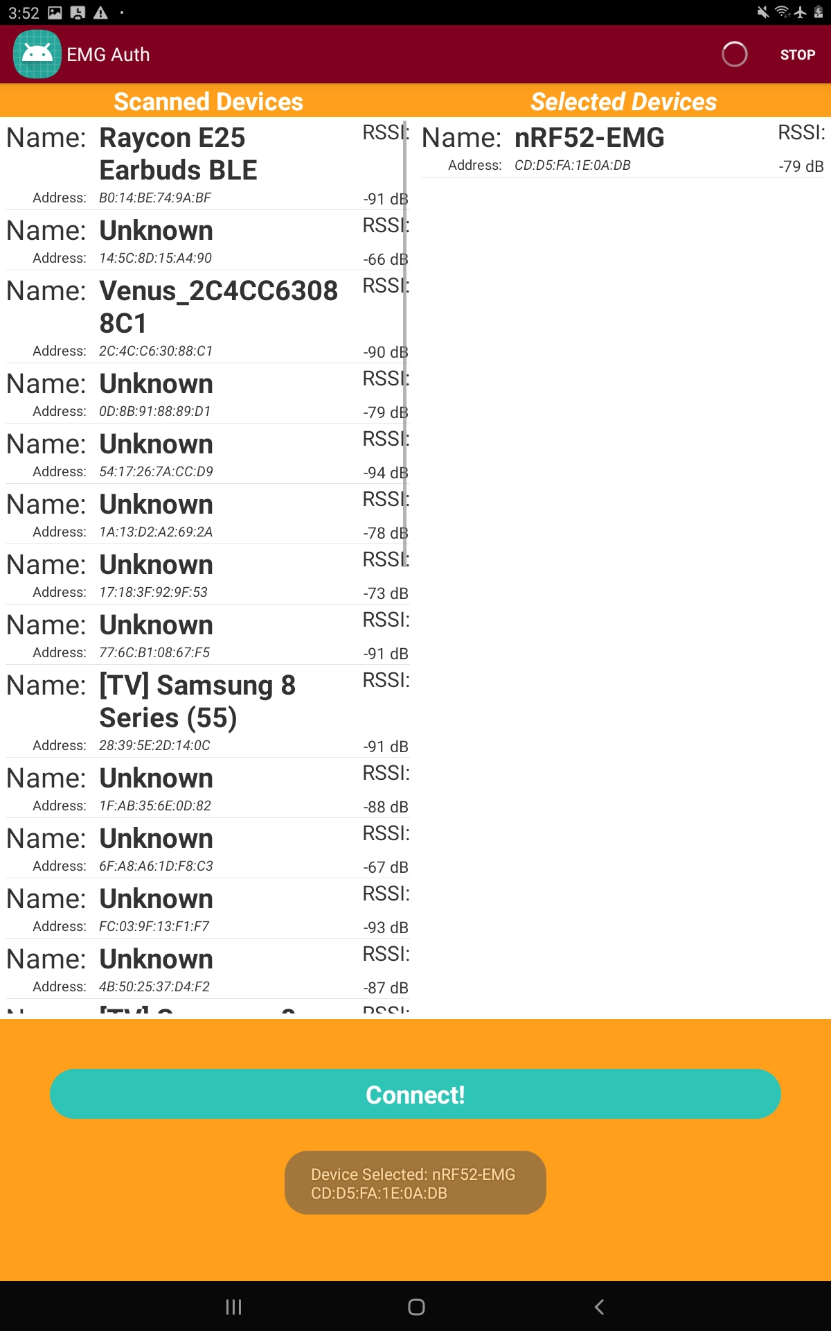
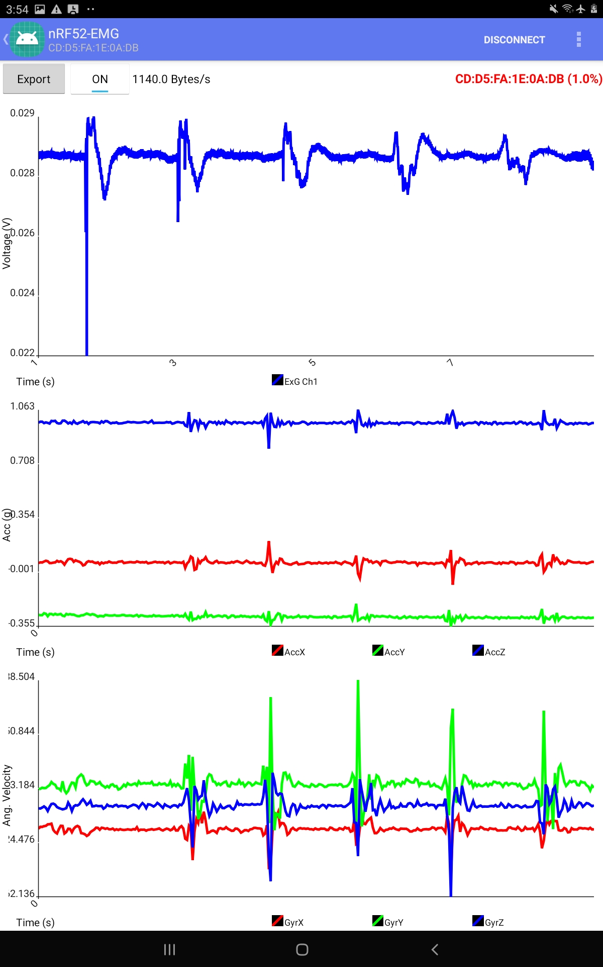
Application - Registration

Slide 12
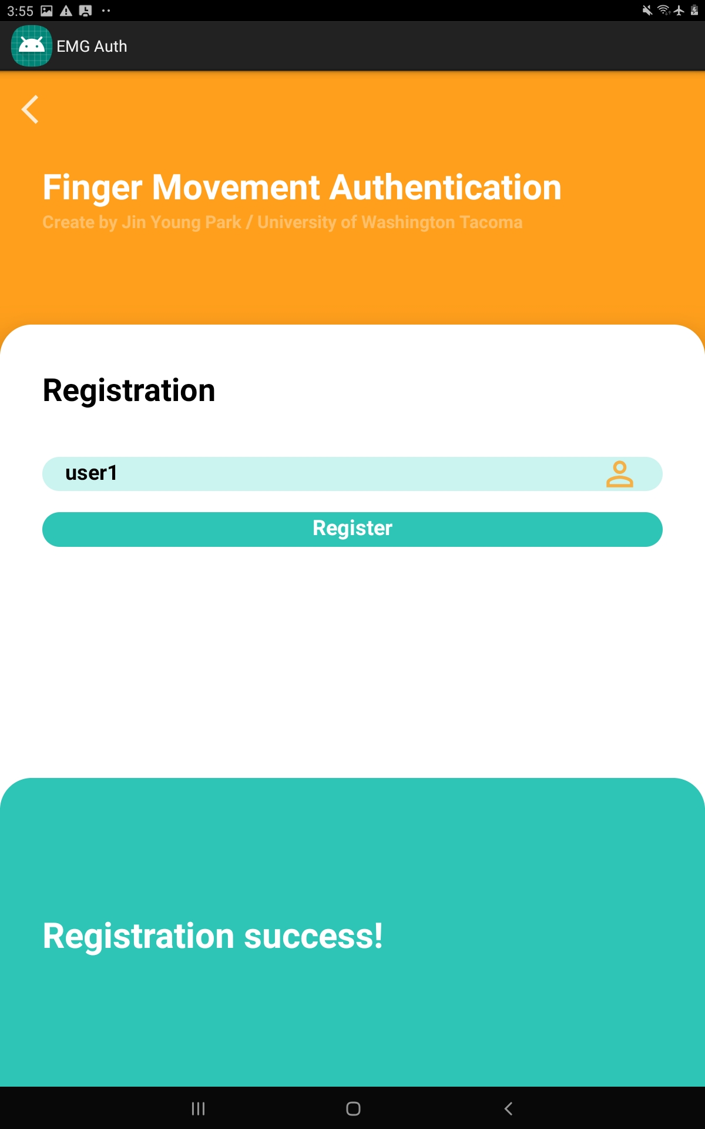
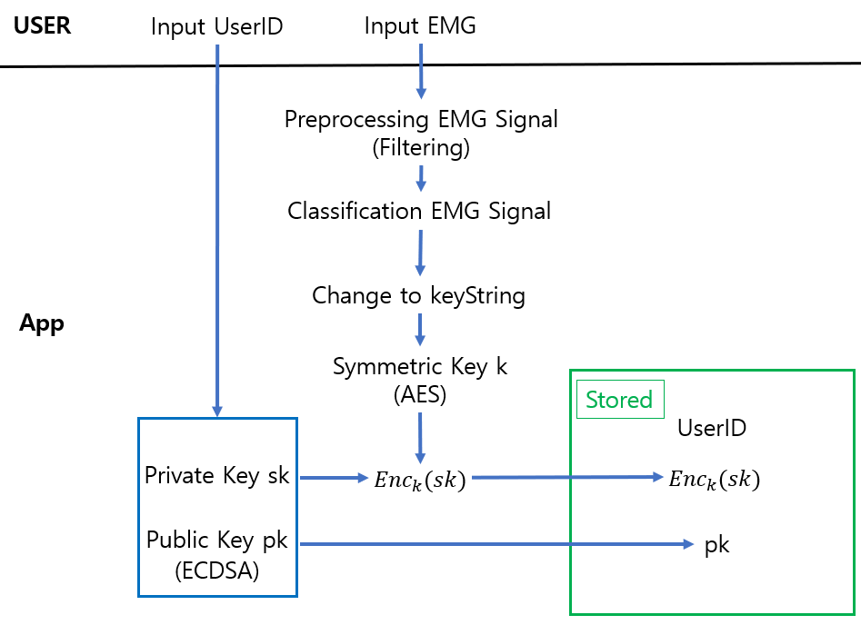
Application - Registration

Slide 13
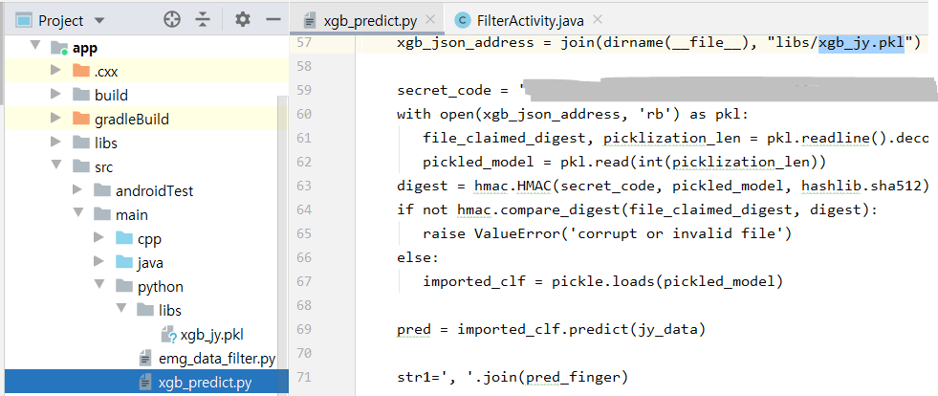
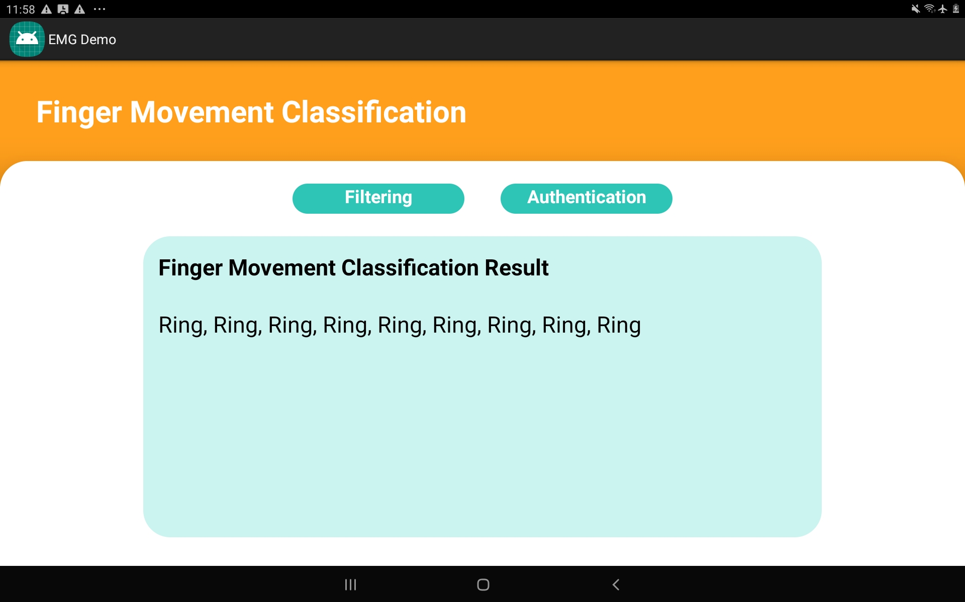
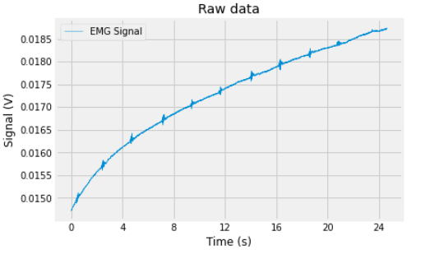
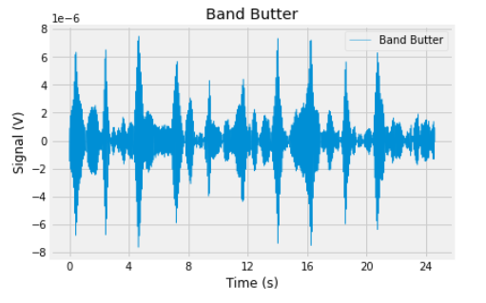
Classificate Finger Movement Data
Filtering
Classification
> Filter the EMG signal using a butterband filter.
> Classify finger movement signals using the pre-trained model (XGBoost and RNN).

Slide 14
Application - Registration

Slide 15

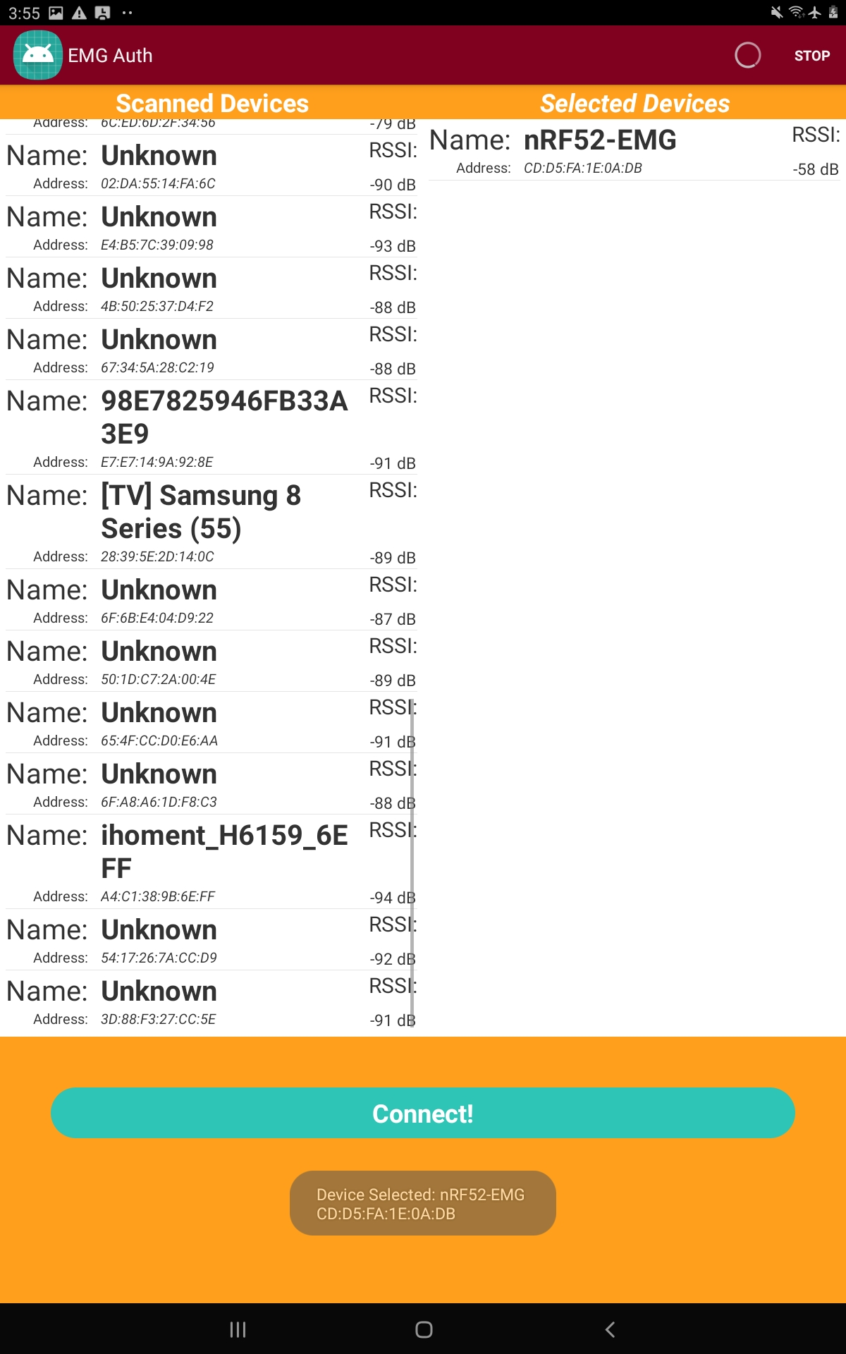
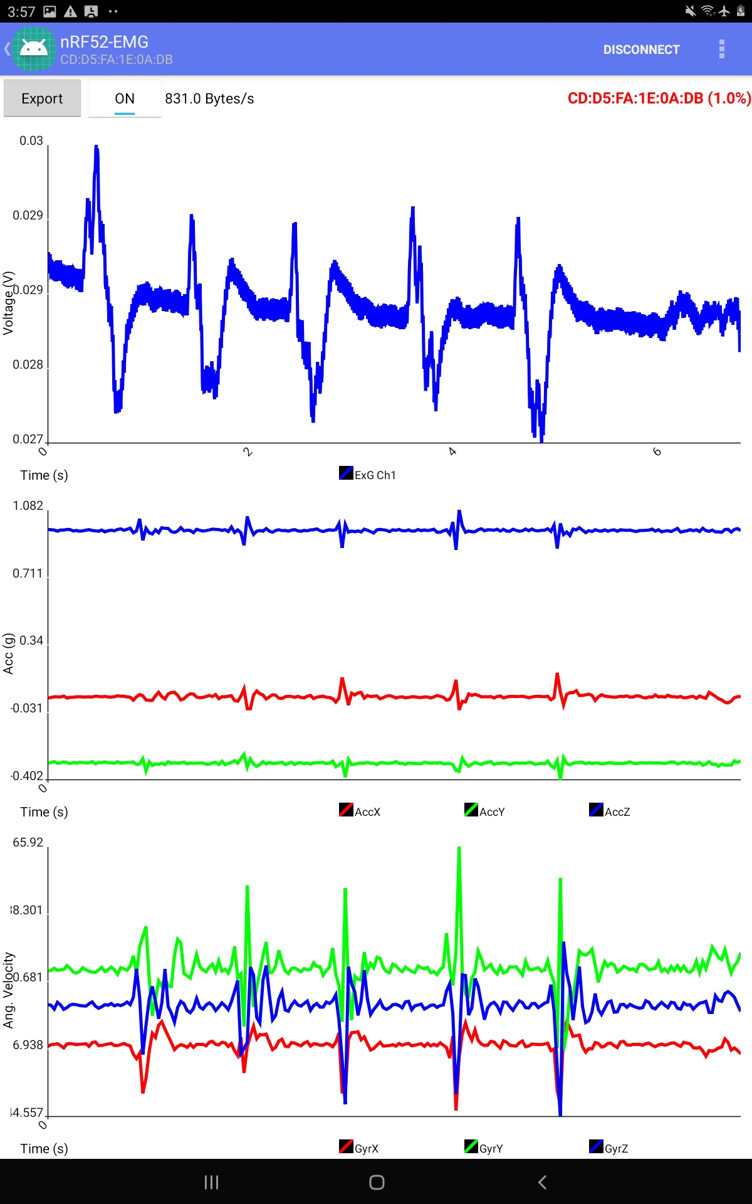
Application - Authentication

Slide 16
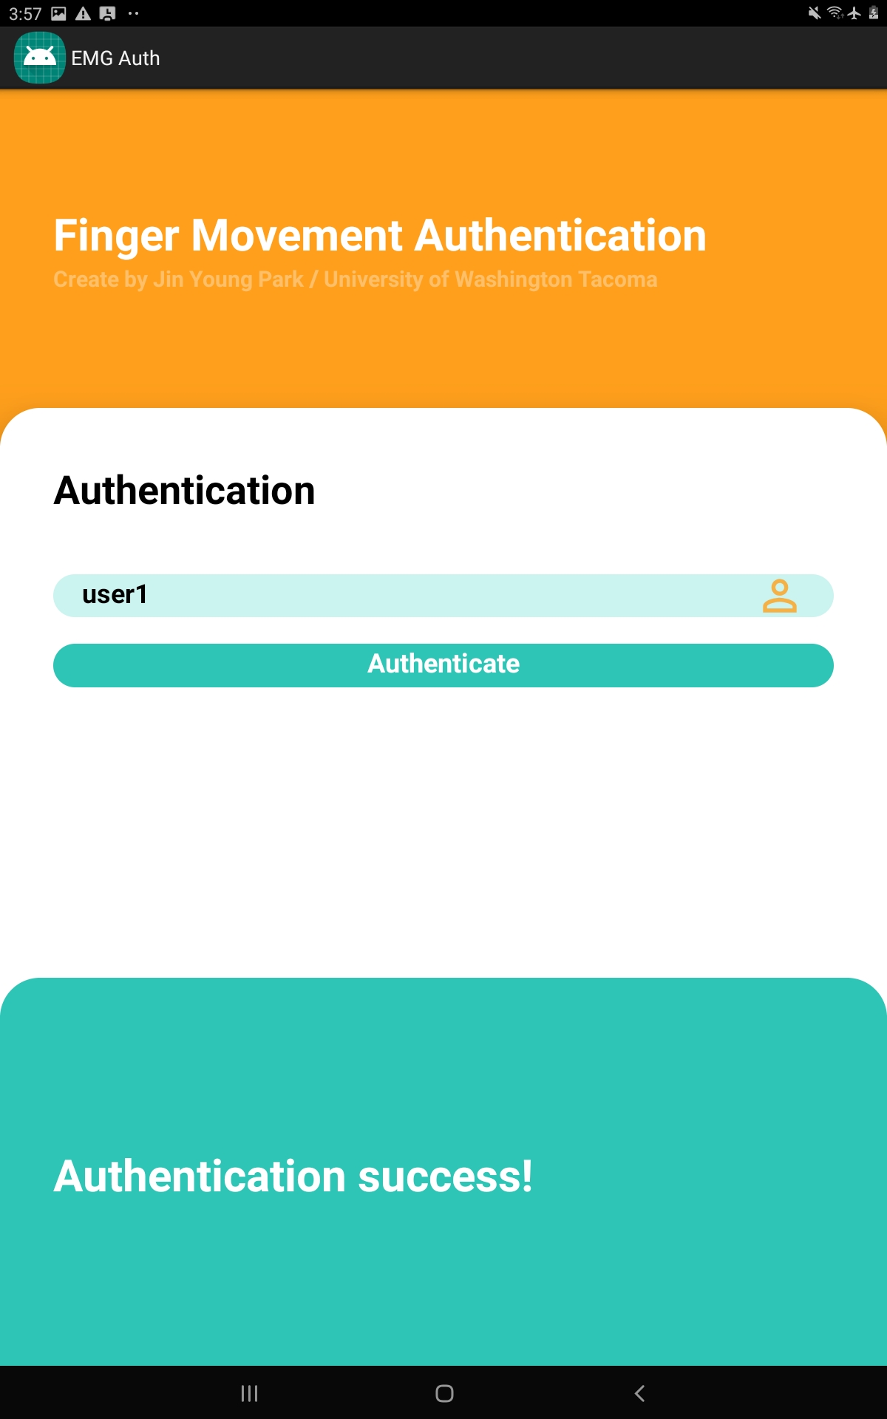
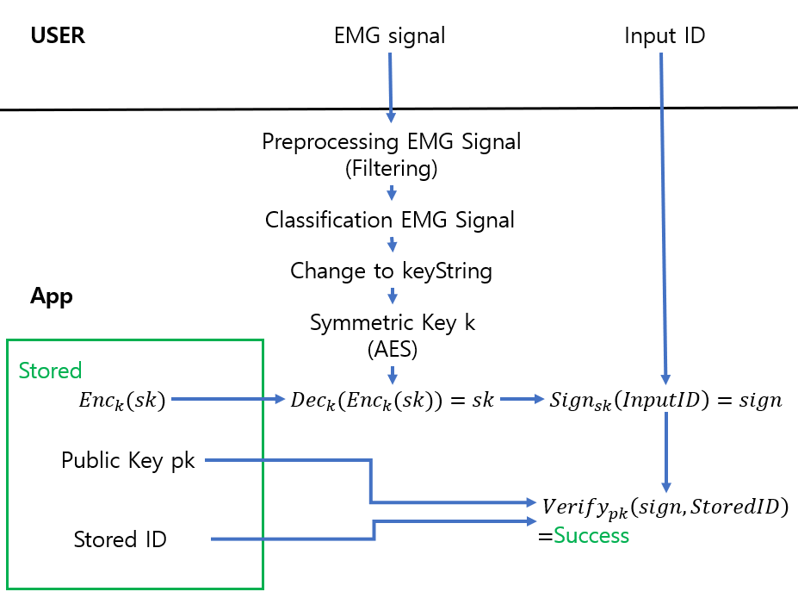
Application - Authentication
Input User ID and signal are registered pair
→Verification Success

Slide 17
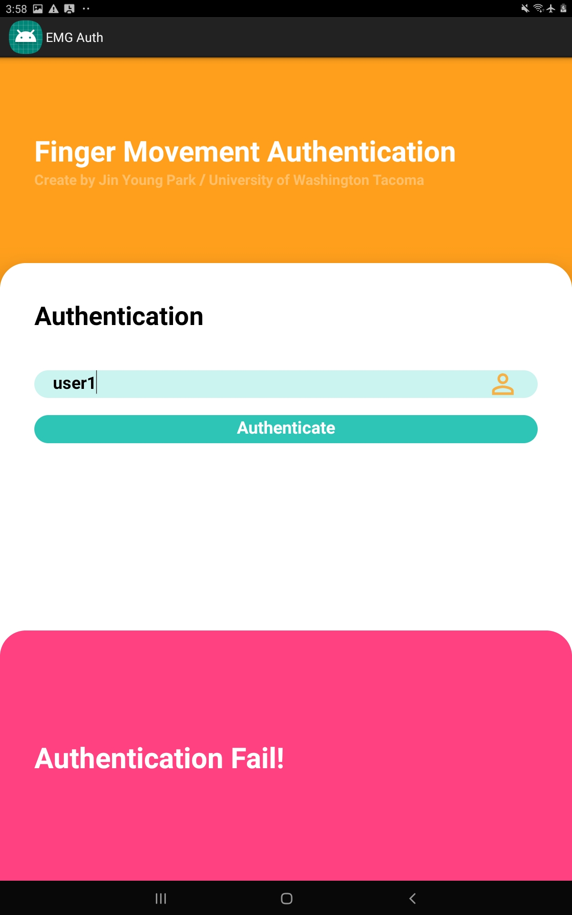
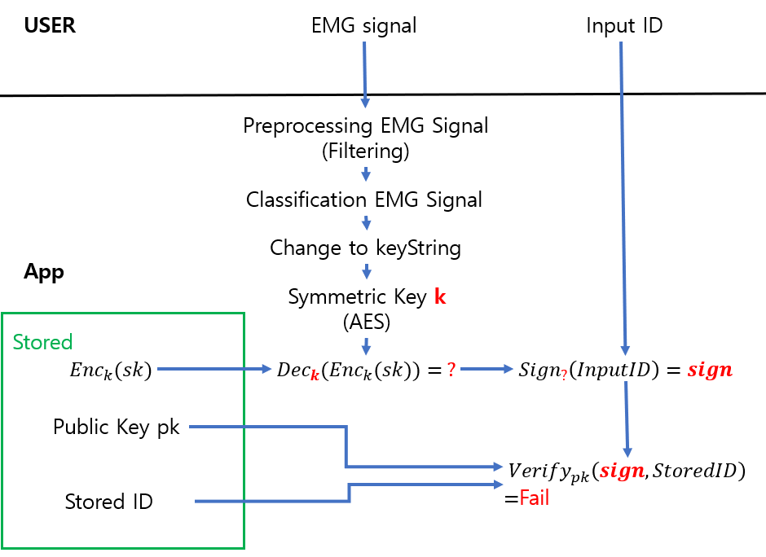
Application - Authentication
Input User ID and signal are not registered pair
→Verification Failure

Slide 18
The Results

Slide 19
Accuracy
 | Thumb | Index | Middle | Ring | Pinky
Trained Data | 1.0 | 1.0 | 1.0 | 0.99 | 1.0
Directed input Data | 0.724 | 0.67 | 1.0 | 0.25 | 0.929

Slide 20
Ring Finger’s Accuracy
 | Thumb | Index | Middle | Ring | Pinky
Ring | 0.0 | 0.053 | 0.053 | 0.158 | 0.737

Slide 21
Conclusion
If the registered finger movement EMG signal and User ID pair is input to the application, user authentication is successful.
When receiving the finger movement EMG signal, it can be classified as different finger’s movement.

Slide 22
Learning Outcomes
Experience in the developing authentication application.
Knowledge of authentication protocol using biotechnology.
Knowledge of data transmission using Bluetooth.
Programing skills in Android studio and Python.
Experience working on the project with team.

Slide 23
Thank you!

